Slide 1
Problem Solving
The Six Step Problem Solving Model

Slide 2
The Six Step Problem-solving Model
Problem solving is the mental process you follow when you have a goal but can’t immediately understand how to achieve it. It’s a process that depends on you – how you perceive a problem, what you know about it, and the end-state you want to reach.
Solving a problem involves a number of cognitive activities:
• ascertaining what the problem really is
• identifying the true causes of your problem and the opportunities for reaching your goal
• generating creative solutions to the problem
• evaluating and choosing the best solution, and
• implementing the best solution
then monitoring your actions and their results to ensure the problem is solved successfully
Clearly, problem solving isn’t a one-step process. Your success will depend on whether you approach and implement each of the stages effectively. The best way to do this is to use a well-established, systematic problem-solving model.

Slide 3
The six steps of problem solving
Problems vary widely, and so do their solutions.
Sometimes a problem and its solution are clear, but you don’t know how to get from point A to point B. At other times, you may find it hard to define what’s wrong or how to fix it.
Regardless of what a problem is, you can use a six-step problem-solving model to address it. This model is highly flexible and can be adapted to suit various types of problems. It also comes with a flexible set of tools to use at each step. The model is designed to be followed one step at a time, but you may find that some stages don’t require as much attention as others. This will depend on your unique situation.
The 6 steps in the problem-solving model are as follows:

Slide 4
1. Define the problem
Defining the problem is a crucial step that involves digging deeper to identify what it is that needs to be solved. The more clearly a problem is defined, the easier you’ll find it to complete subsequent steps. A symptom is a phenomenon or circumstance that results from a deeper, underlying condition. It’s common to mistake symptoms for problems themselves – and so to waste a lot of time and effort on tackling consequences of problems instead of their causes. To define a problem, you can use gap analysis, which involves comparing your current state to the future state you want to be in, to identify the gaps between them.
Notes:
PHENOMEMON - a fact or situation that is observed to exist or happen, especially one whose cause or explanation is in question.
Motherboard issue started as a keyboard issue changing from lower case to upper.

Slide 5
2. Analyze the problem
You decide what type of problem it is – whether there’s a clear barrier or circumstance you need to overcome, or whether you need to determine how to reach a goal. You then dig to the root causes of the problem, and detail the nature of the gap between where you are and where you want to be. The five-why analysis is a tool that’ll help you get to the heart of the problem. Ask “Why?” a number of times to dig through each layer of symptoms and so to arrive at the problem’s root cause. You can get to the root of a more complicated problem using a cause-and-effect diagram. A cause is something that produces an effect, result, or consequence – or what contributed to the current state of affairs. Categories of causes include people, time, and the environment.
Notes:
Two diagrams follow in two slides - to give better understanding to five whys

Slide 6
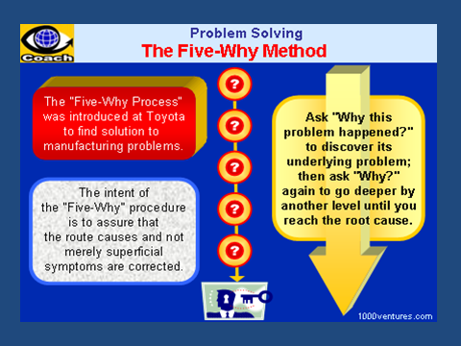

Slide 7
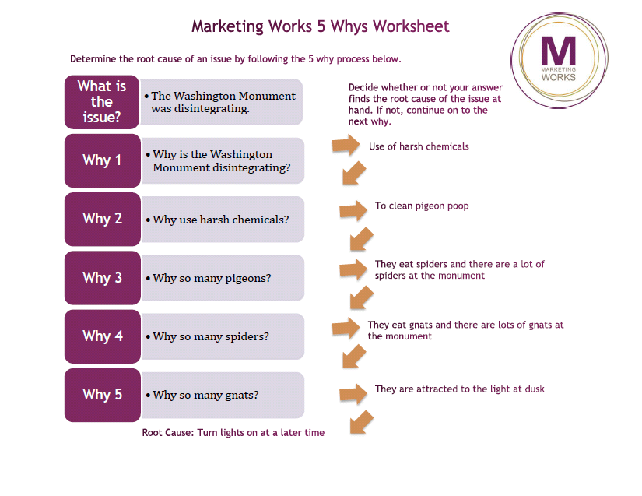

Slide 8
3. Identify as many potential solutions as you can
Brainstorm creatively – ask lots of questions about the who, what, where, when, and how of the causes to point to various possibilities.
Don’t limit yourself by considering practicalities at this stage; simply record your ideas.

Slide 9
4. Choose the best solution
In evaluating your ideas, more options could present themselves. You could do this by rating each possible solution you came up with in step 3 according to criteria such as how effective it will be, how much time or effort it will take, its cost, and how likely it is to satisfy stakeholders.

Slide 10
5. Plan of action
During this step, you determine what steps must be taken, designating tasks where necessary. And you decide on deadlines for completing the actions and estimate the costs of implementing them. You also create a contingency plan in case of unforeseen circumstances so that if anything goes wrong with your plan, you have a “plan B” in place. Typically, this stage involves narrowing down the possible ways to implement the solution you’ve chosen, based on any constraints that apply. You also should draw up an action plan. The complexity of the plan will depend on the situation, but it should include the who, what, and when of your proposed solution.

Slide 11
6. Implement\evaluate the solution
This is an on going process. You need to ensure the required resources remain available and monitor progress in solving the problem; otherwise, all the work you’ve done might be for nothing. In simplest terms, evaluation is the monitoring that any project needs to ensure that milestones are met, costs are contained, and work is completed. Unfortunately, most technicians neglect or short-change the evaluation step, and therefore do not get the continued results or performance they were hoping to achieve. Effective technicians, however, plan additional feedback mechanisms to detect the need for midcourse corrections and to ensure that the problem is solved without creating new problems. Collecting data and reporting on what has been accomplished also keeps a technician credible with its constituents. Finally, reflecting on their own processes and results keeps a technician effective. It also brings the problem-solving process full circle, as reflecting on results helps a technician identify their next step.

Slide 12
Summary
Remember that this model is highly adaptable. Although you shouldn’t skip any of the six steps, you can tailor the amount of time you spend on each stage based on the demands of your unique situation.
The six-step problem-solving model, and the tools it provides, is an effective, systematic approach to problem solving. By following each step consciously, you can ensure that generating solutions is a fact-driven, objective, and reliable process. It encourages you to dig deeper to the root cause, allows you to get input from others, to be creative when finding solutions, and to monitor your solutions to make sure they’re working. So by following this model you’re more likely to come up with good, original, lasting solutions.

Slide 13
Summary cont.d
To solve problems effectively, you need to use a good problem-solving model. The six-step model is a tried-and-tested approach. The steps include:- Defining a problem, Analyzing the problem, Identifying possible solutions, Choosing the best solution, Planning your course of action, and finally Implementing the solution while monitoring its effectiveness.

